Slide 1
Dominic Rucci
Sabina Aguon
Brady Cusack
Ryan Penkusky
Group 5
Vladimir Yuditsky
Abdulai Dibasy
Colin Jose
Justin Jones

Slide 2
User Requirements
Use Case & Sequence Diagram
HLA & Class Diagram
Repo Setup
SW Project Management Plan

Slide 3
User Requirements:
Brief Overview:
Web based program accessible through the school’s website
Defined user roles
People can rent the facilities only when not in use
There should be a registration process for new schools
There should be a sign-up option for members
There should be a registration process for new users
They can schedule ahead of time.
Can also be used to advertisement for school functions
Should accept online donations
Event info should be downloadable in clean format
There should be a user-friendly method of organizing the facilities

Slide 4
Use Case

Slide 5
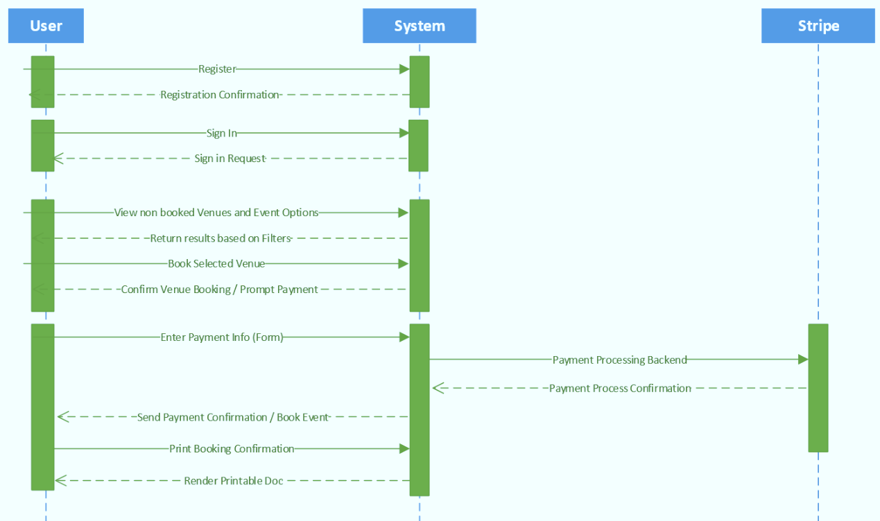
Sequence
Diagram

Slide 6
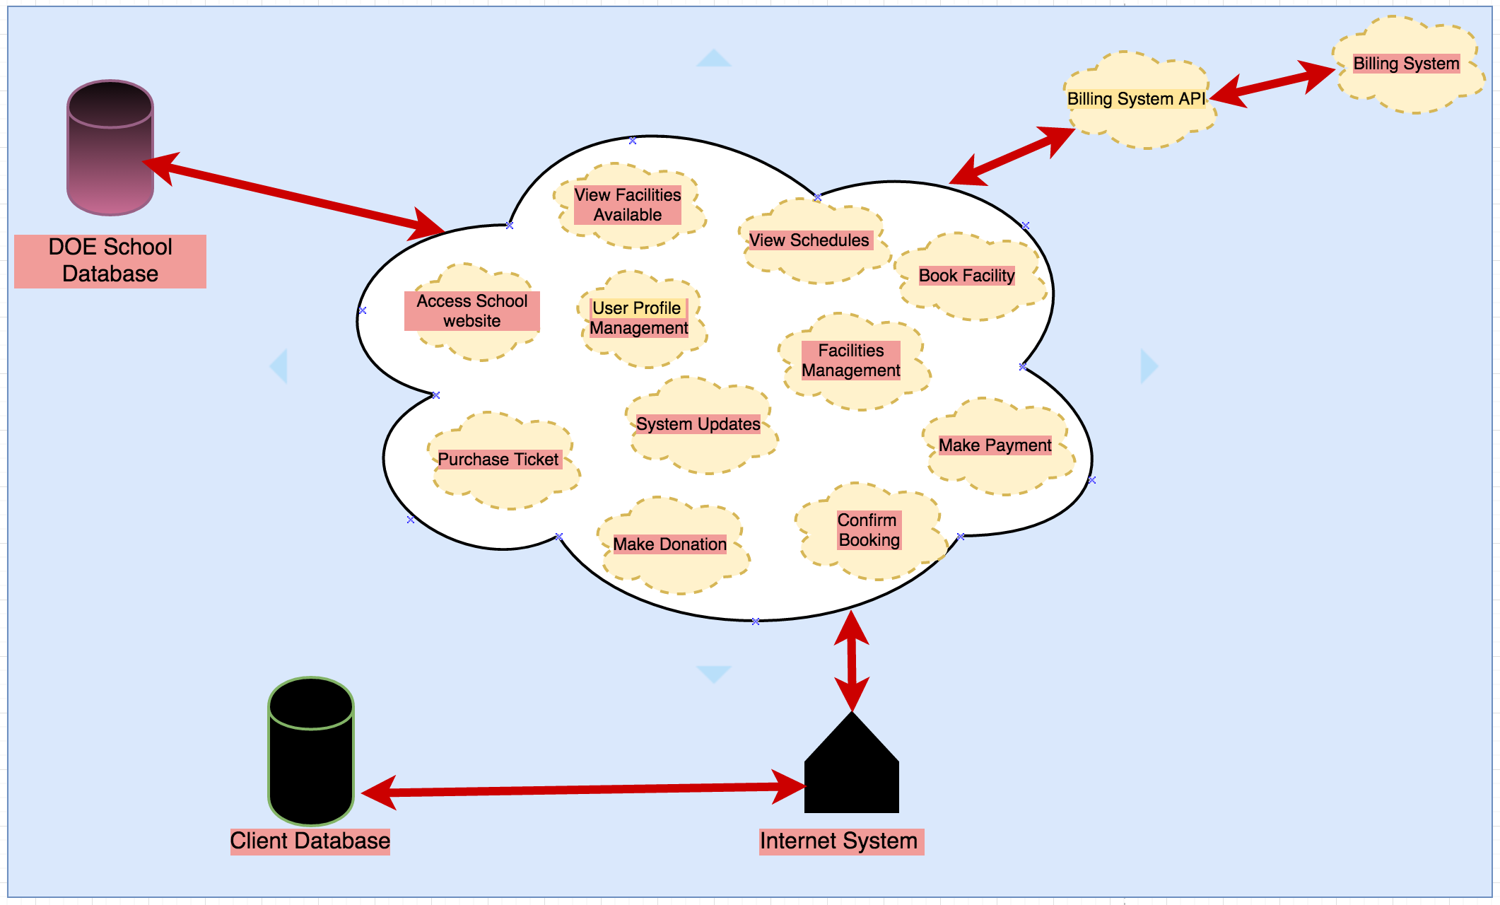
HLA Diagram

Slide 7
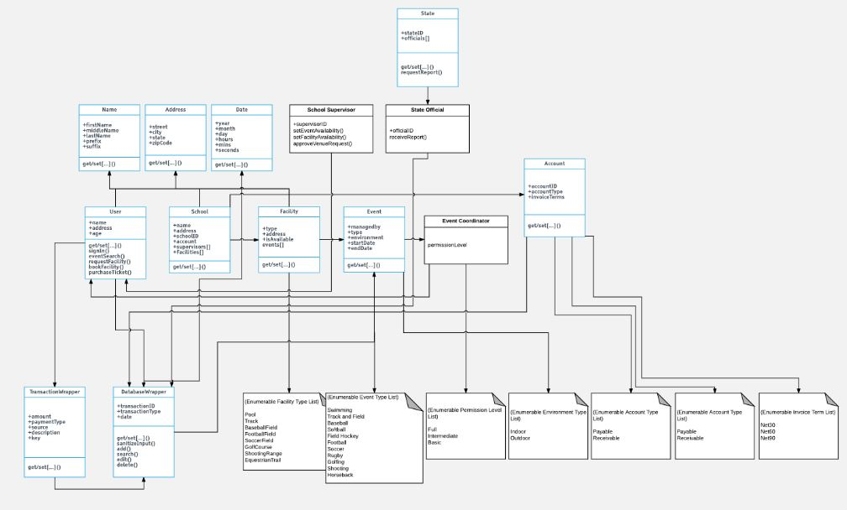
Class Diagram

Slide 8

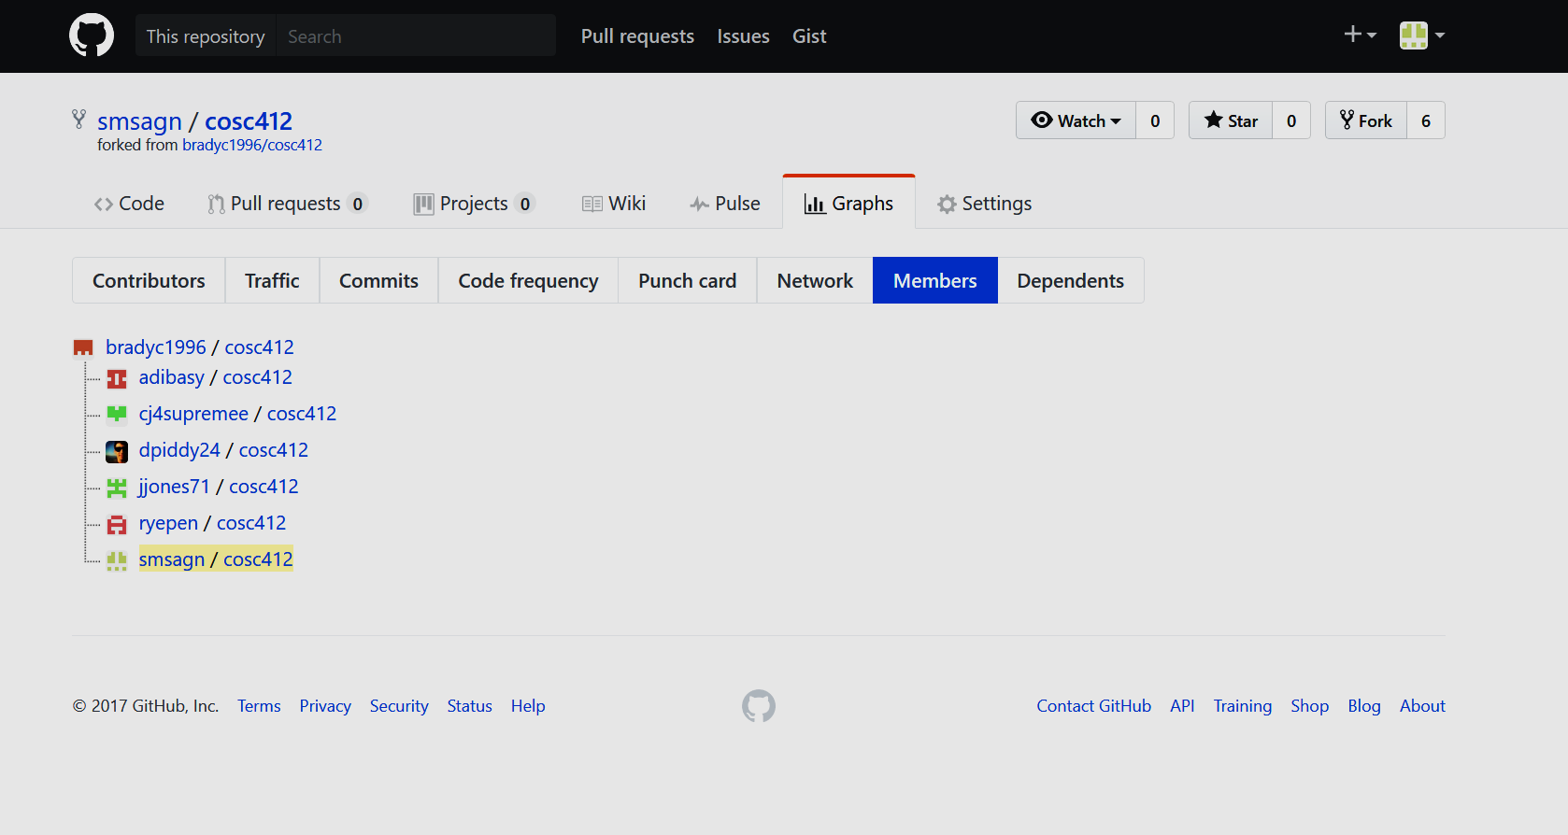
GitHub

Slide 9
Software Project Management Plan
Role
Delegation
Means of Communication
Project Collaboration
Determine Risks and Mitigation Techniques

Slide 10
Any Questions?

Slide 11
Credits
Presentation template by SlidesCarnival
Photographs by Unsplash

